Slide 1
Office 365 Development

Slide 2
Course Agenda
Introduction to Office 365 Development
Module 1: Overview of Office 365 Development
Module 2: Getting started with Apps for Office
Module 3: Getting started with Apps for SharePoint
Module 4: Getting started with the Office 365 APIs
Module 5: Moving Full Trust Code to the Cloud Using Repeatable Patterns and Best Practices
Module 6: Getting started with Mobile development with Office 365
Module 7: Setting up your Developer environment in Office 365
Module 8: Setting up your on-premises environment for app development

Slide 3
Getting started with Mobile development with Office 365

Slide 4

Agenda
Intro
Windows Platform
Non-windows Platforms
Multi-platforms

Slide 5
Intro
Getting started with Mobile development with Office 365

Slide 6
Choices for Mobile Development
Target the Windows Platform
Develop apps that run in Windows and Windows Phone
Target the Android Platform
Develop apps that run on Android devices
Target the iOS Platform
Develop apps that run on iOS devices such as iPhone and iPad
Target Multiple Platforms
Develop apps which can be targeted for more than one platform
Use Cordova to develop apps which target Android, iOS and Windows Phone
Use Xamarin to develop apps which target Android, iOS and Windows Phone

Slide 7
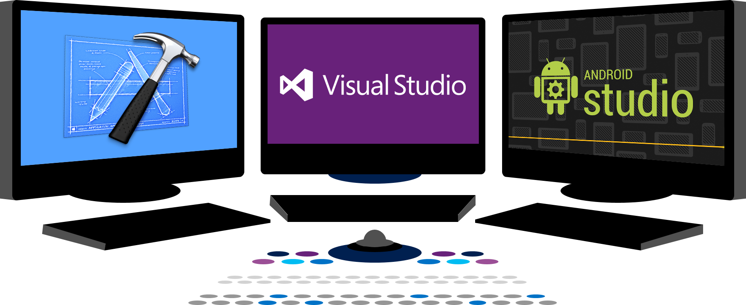














Vision
EXTEND OFFICE EVERYWHERE
CONNECT TO OFFICE 365 SERVICES
BUILD USING AN OPEN PLATFORM
Delve
z
Users and groups
Files
Mail
Calendar
My Apps
Video Portal
Contacts
Office Graph
Presentations
Documents
Spreadsheets
Lync
OneNote
Yammer

Slide 8
Windows Platform
Getting started with Mobile development with Office 365

Slide 9
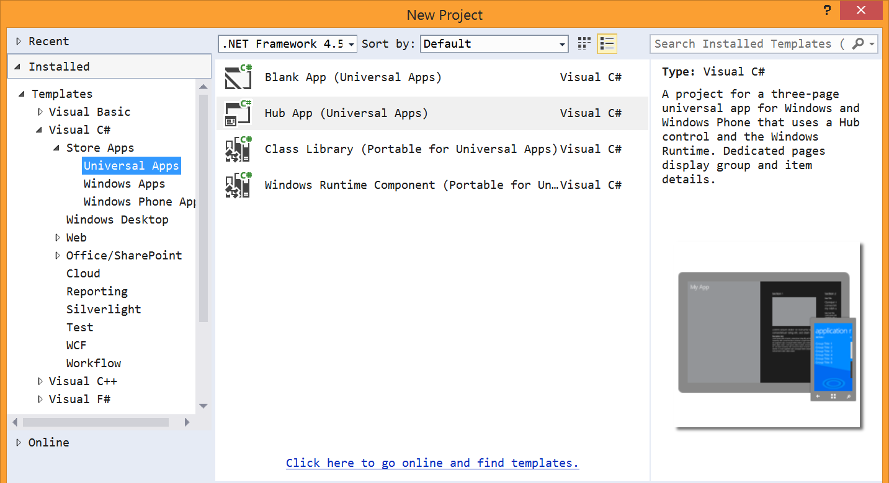
Universal App project template

Slide 10
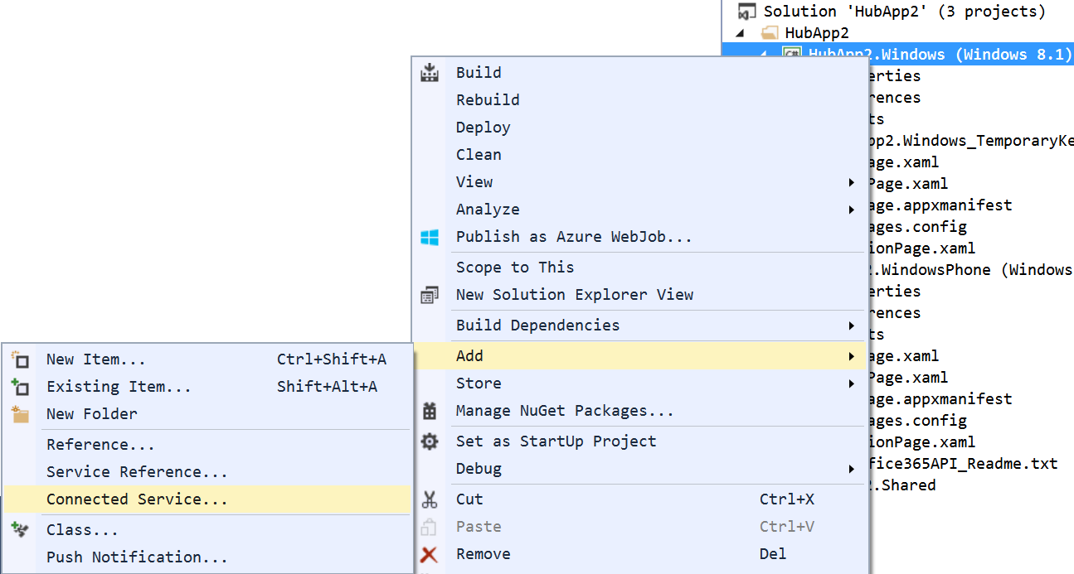
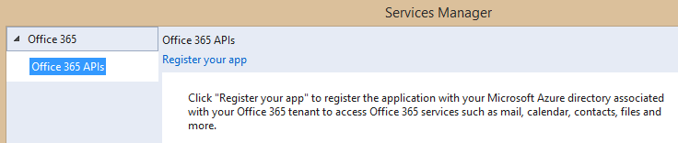
Adding Connected Services
1
Project > Add > Connected Service…
2
Register your app

Slide 11
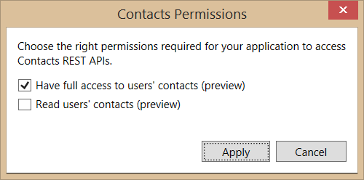
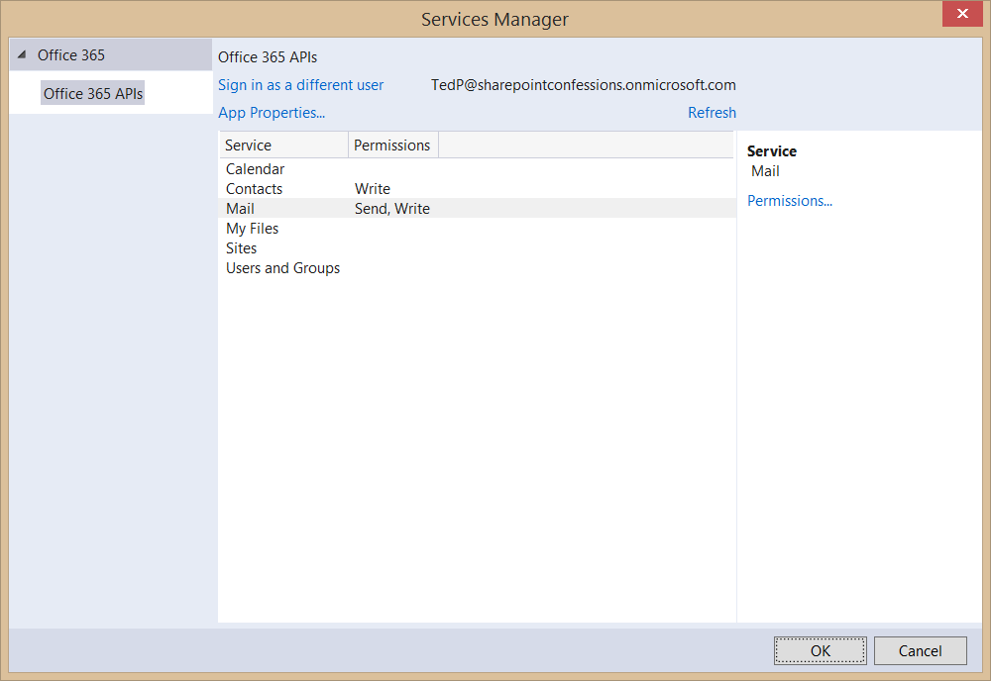
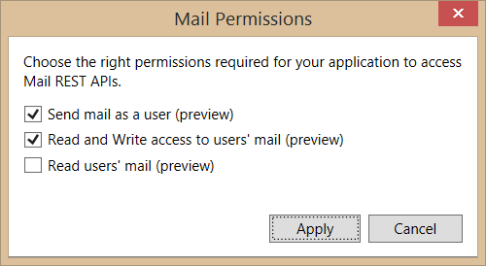
Connected Services Permissions
3
Select required app permissions

Slide 12
“Client” object constructor example
return new ExchangeClient(ExchangeServiceEndpointUri, async () =>
{
return (await _discoveryContext.AuthenticationContext
.AcquireTokenSilentAsync(
ExchangeServiceResourceId,
_discoveryContext.AppIdentity.ClientId,
new ActiveDirectory.UserIdentifier(
dcr.UserId,
UserIdentifierType.UniqueId)
)
).AccessToken;
});

Slide 13
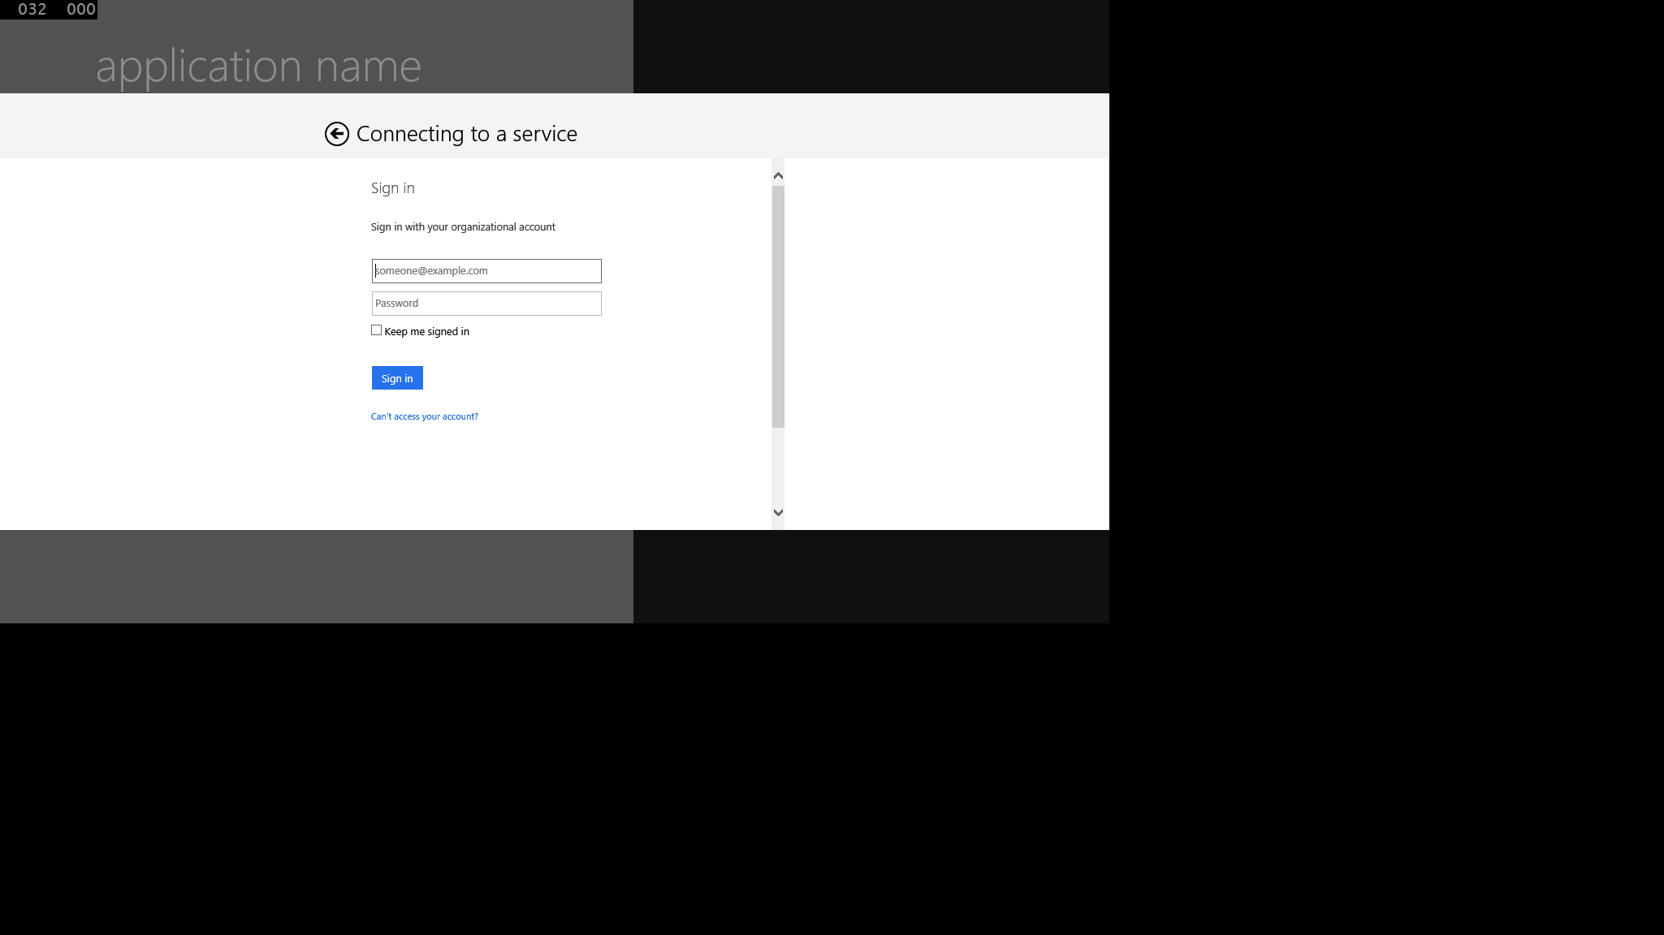
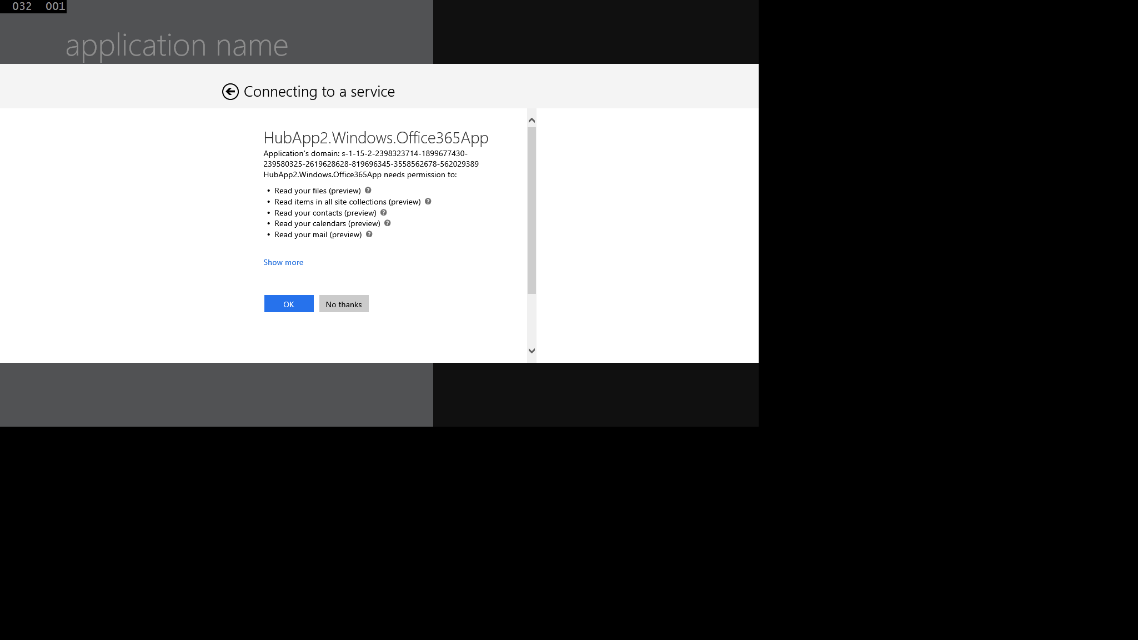
Authentication UI

Slide 14
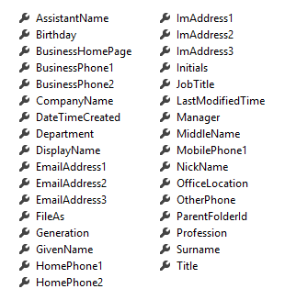
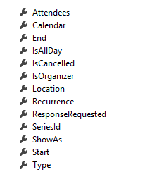
Office 365 Service Communication
Client Object exposes properties
Most are IEnumerable<T> collections
Designed much like Entity Framework
Client == DataContext
IEnumerable<T> entities
Includes common CRUD operations
Contact
Event

Slide 15
demo
WINDOWs 8

Slide 16
Native Platforms
Getting started with Mobile development with Office 365

Slide 17
Getting Started with the Android SDK

Slide 18
The New Android Platform IDE

Slide 19
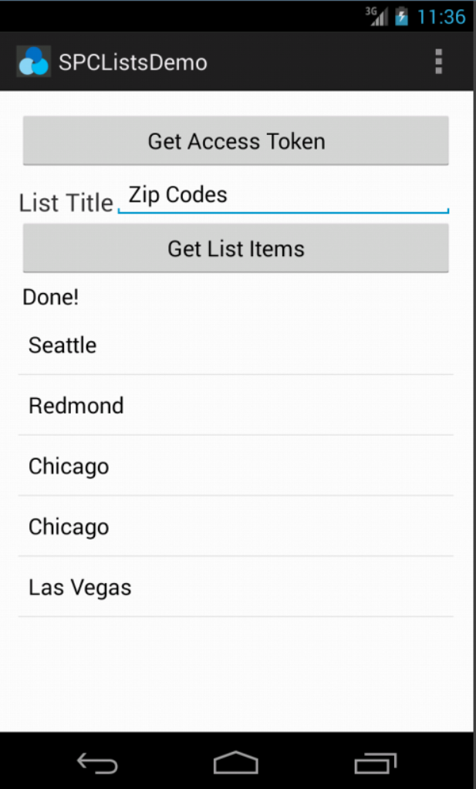
Office 365 SDK for Android
Available today on GitHub
http://dev.office.com/Android
SDK for native Android apps that use Office 365 APIs
Handles files, lists, contact, mail, and calendar
Integrates with AD authentication library

Slide 20
demo
ANDROID

Slide 21
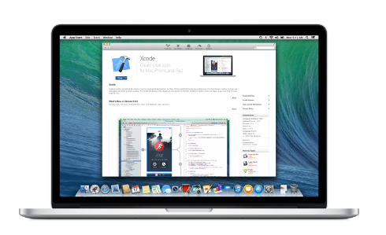
Developing for iOS
Developing for iOS requires a Mac (or something running iOS)
Apple does not permit compilation of iOS apps on a non-iOS computer or device
You either need (1) a Mac or (2) a Windows PC that’s paired with a Mac nearby
Developing iOS apps
The primary programming language is Objective C
Many developers use the XCode IDE provided by Apple
XCode also installs iOS SDK

Slide 22
Office 365 SDK for iOS
Available today on GitHub
http://dev.office.com/iOS
SDK for native iOS apps that use Office 365 APIs
Handles files, mail, contact and calendar
Integrates with AD authentication library

Slide 23
demo
iOS

Slide 24
Multi-platform
Getting started with Mobile development with Office 365

Slide 25
What is a Hybrid App?
An app created with HTML5, CSS3 and JavaScript
Available through an app store
Different than a mobile web site
Hybrid app runs in browser of mobile device
Chromeless (no browser title bar, navigation buttons, etc.)
HTML, CSS and JavaScript downloaded and run locally from device
App launched in full screen mode
User isn’t aware that app is using browser

Slide 26
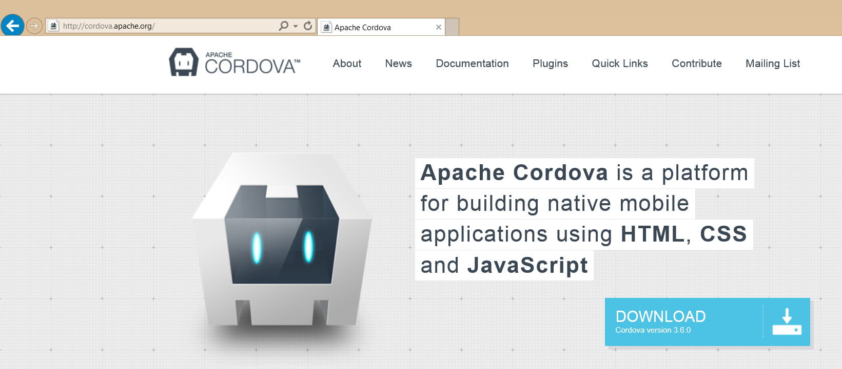
What is Cordova?
A platform for developing hybrid apps with HTML, CSS and JavaScript
An open source collection of JavaScript device APIs
Something that abstracts away device specific APIs
Toolsets built on top of Cordova
PhoneGap (Abode)
AppBuilder (Telerik)

Slide 27
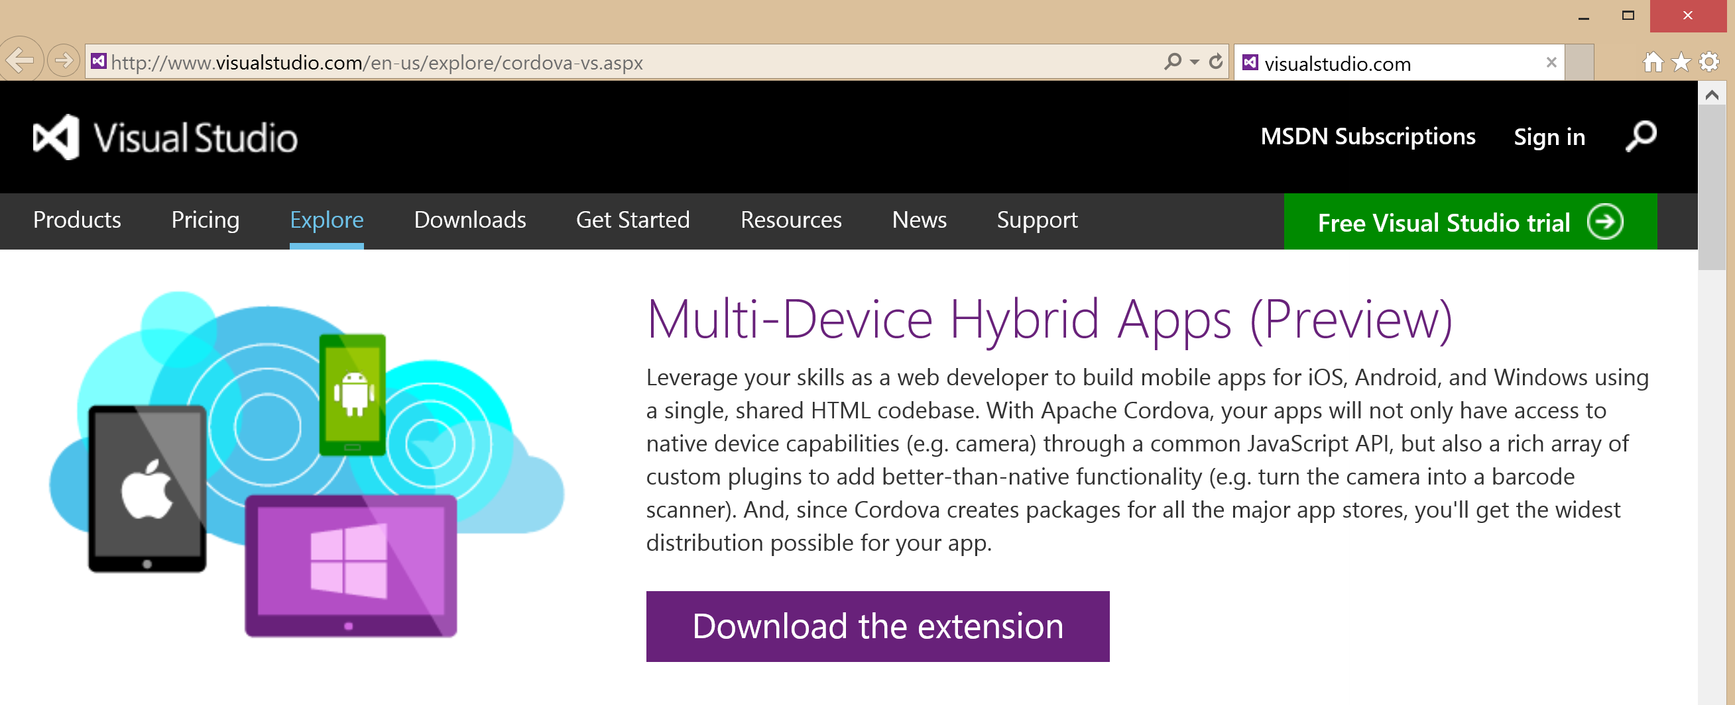
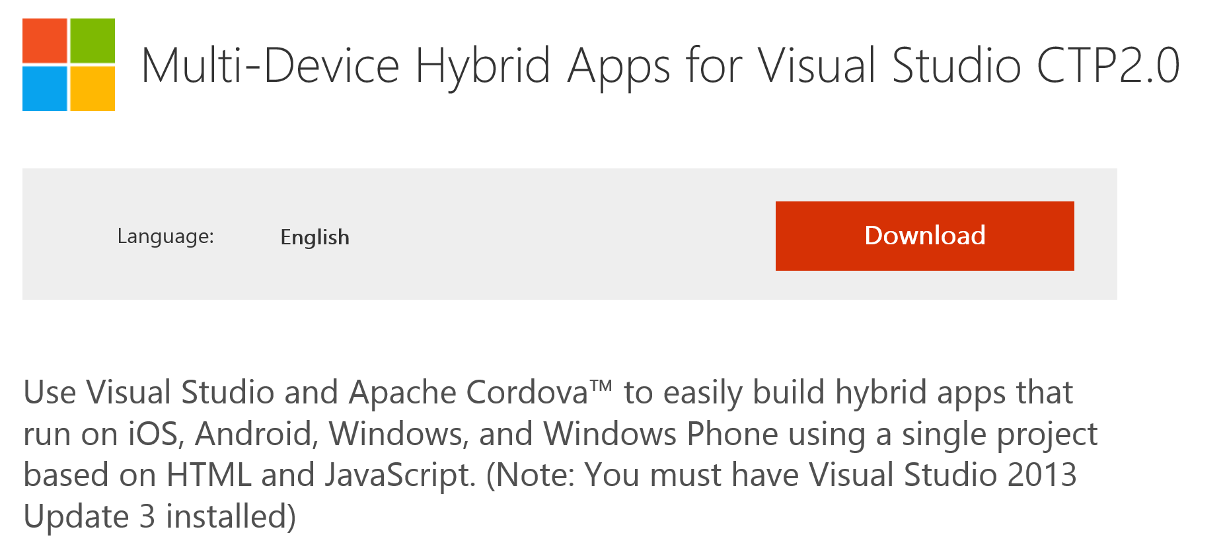
Multi-Device Hybrid Apps for Visual Studio

Slide 28
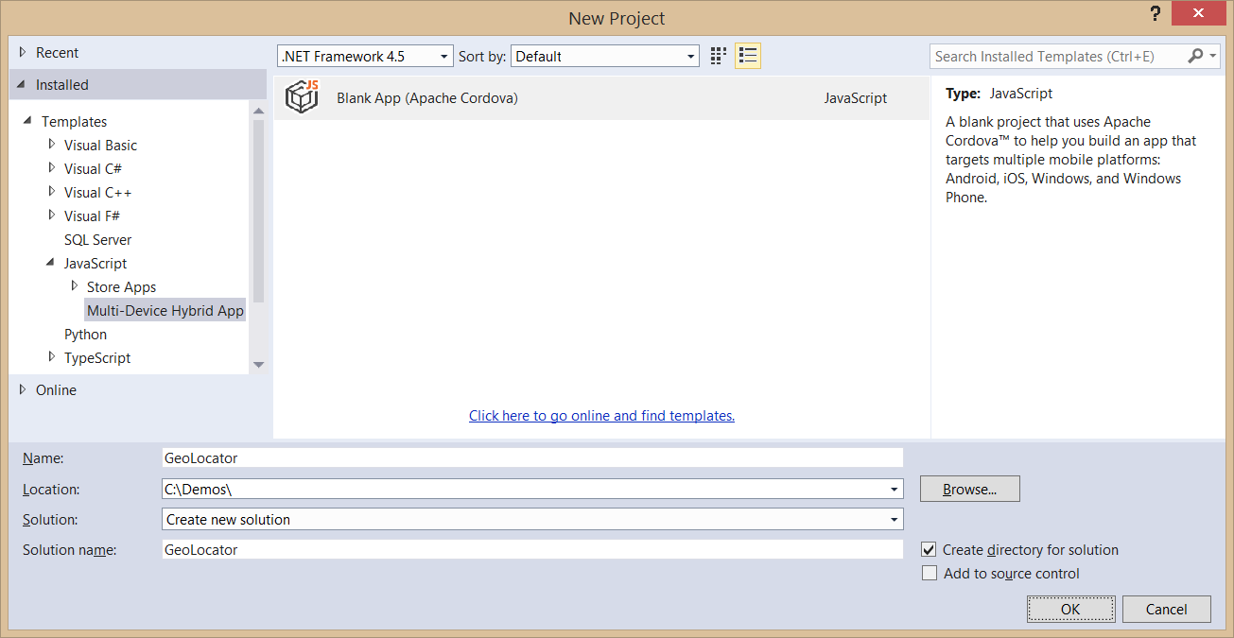
Creating a Cordova App
Use the Blank App (Apache Cordova) template
Templates > JavaScript > Multi-Device Hybrid Apps

Slide 29
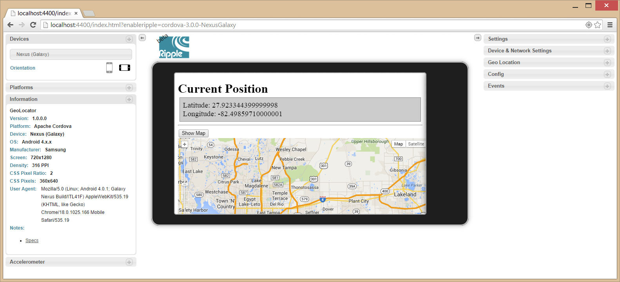
Debugging with Ripple
Included with Android SDK
Runs inside Chrome browser

Slide 30
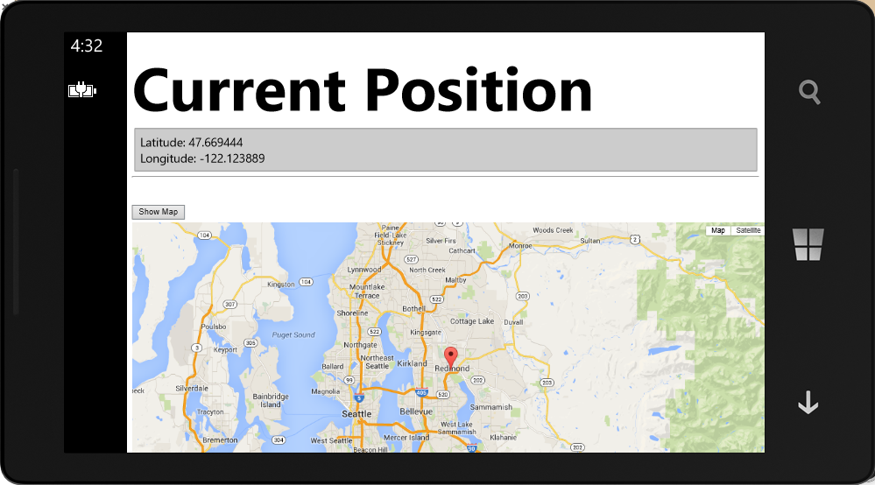
Debugging with Windows Phone
You can use a Windows Phone emulator
You can use an attached Windows Phone device

Slide 31
demo
Cordova

Slide 32
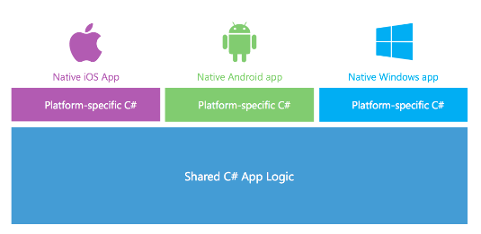
What is Xamarin?
A Company and a Development Platform
Developing on Xamarin platform requires monthly or yearly subscription
You can get a free 30-day trial (90-day trial available for MSDN subscribers)
Xamarin Development based on the .NET framework
You write code using C# and the .NET framework class libraries
Xamarin Platform supported across many OSs and devices
Android
iOS and Mac
Windows and Windows Phone

Slide 33
Evolution of the Xamarin Platform
Xamarin Platform’s Key Value Proposition
Provide update-to-date versions of .NET on Xamarin.iOS and Xamarin.Android
Allow you to leverage skills you already have with Visual Studio, C# and .NET
Support latest C# features such as support for async and await
iOS
iOS
MonoTouch
Xamarin.iOS
Linux
Mono
CLR & .NET
Android
Android
Mono for Android
Xamarin.Android

Slide 34
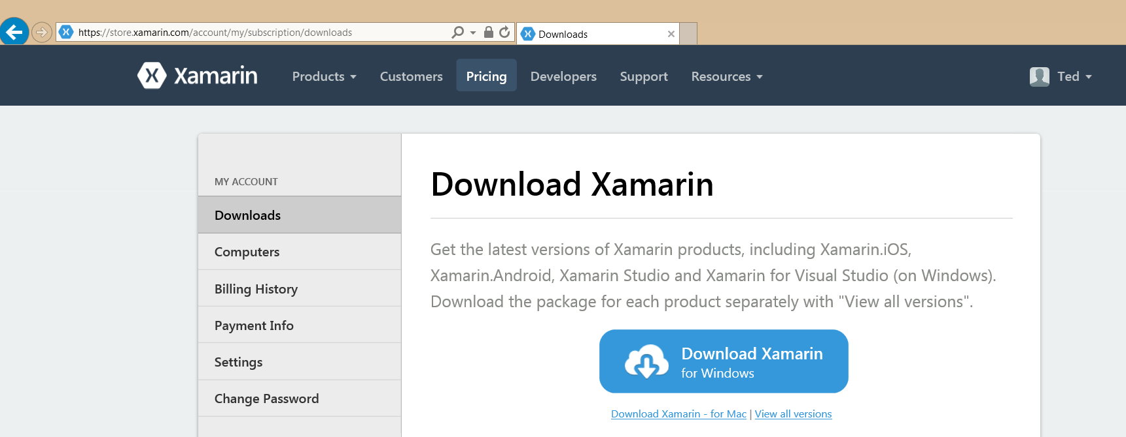
Xamarin Setup
Visual Studio 2013 with Update 4
Install Xamarin

Slide 35
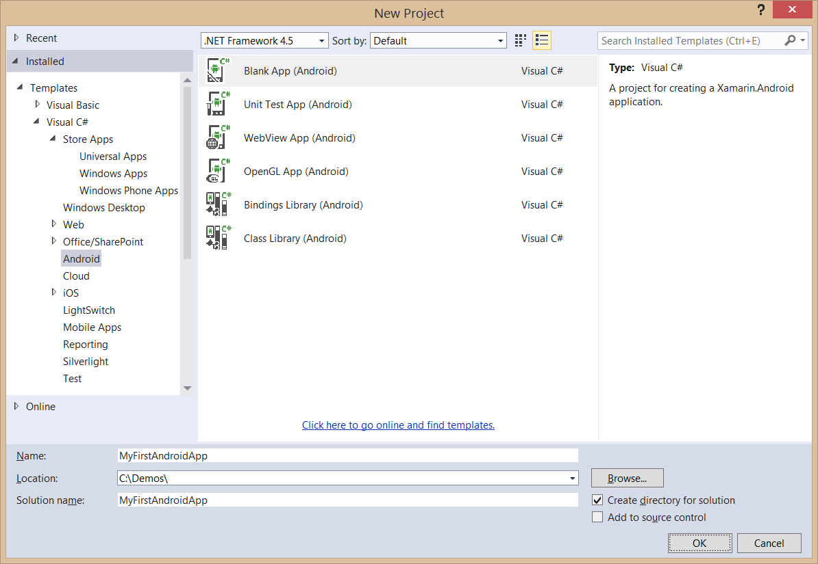
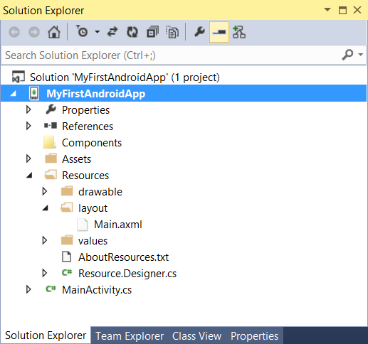
Creating an Android App Project

Slide 36
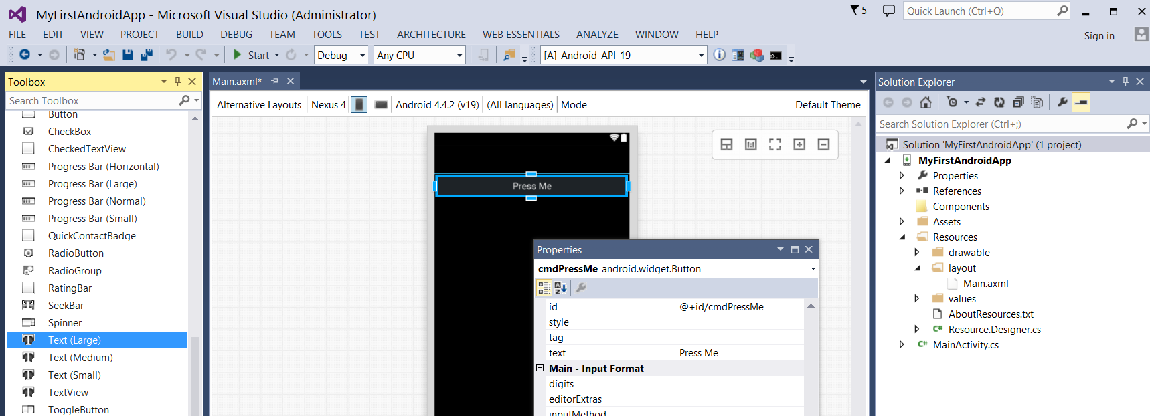
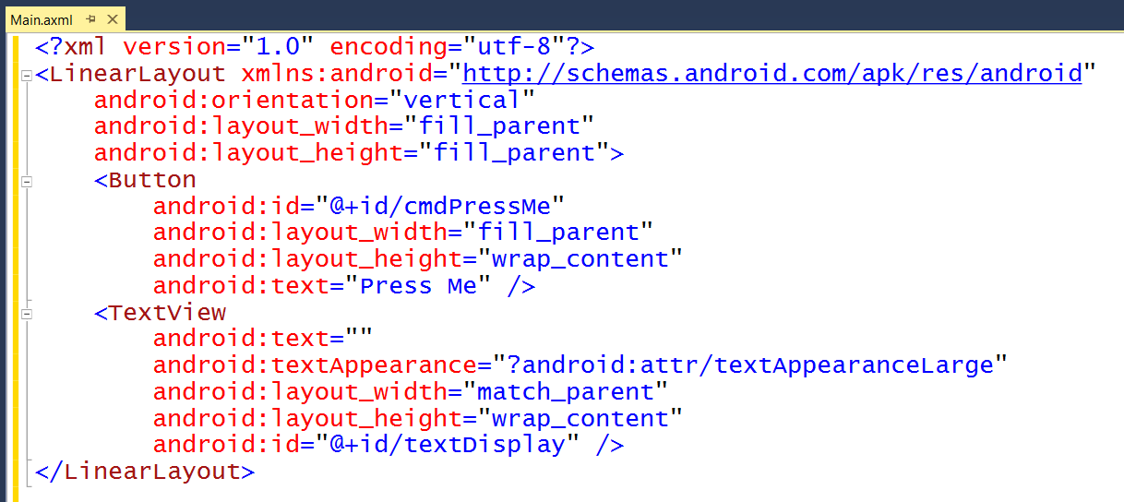
Android Layouts
UI layout decoupled from UI management code
UI Layouts created in XML-based resource files with .axml extensions
Xamarin adds Android layout design editor into to Visual Studio

Slide 37
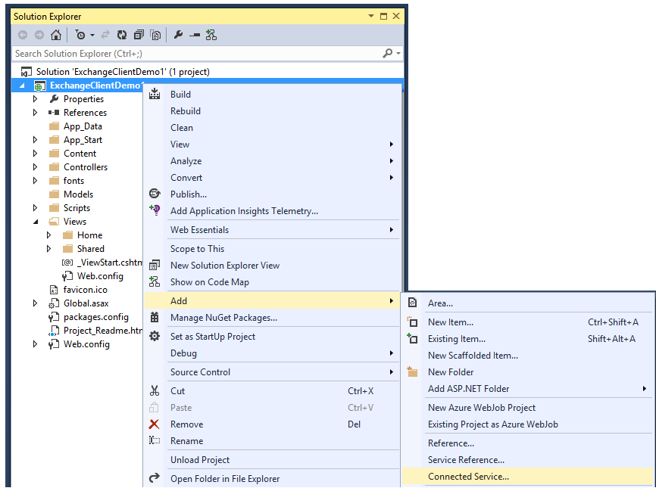
Adding Connected Services
1
Project > Add > Connected Service…
2
Register your app

Slide 38
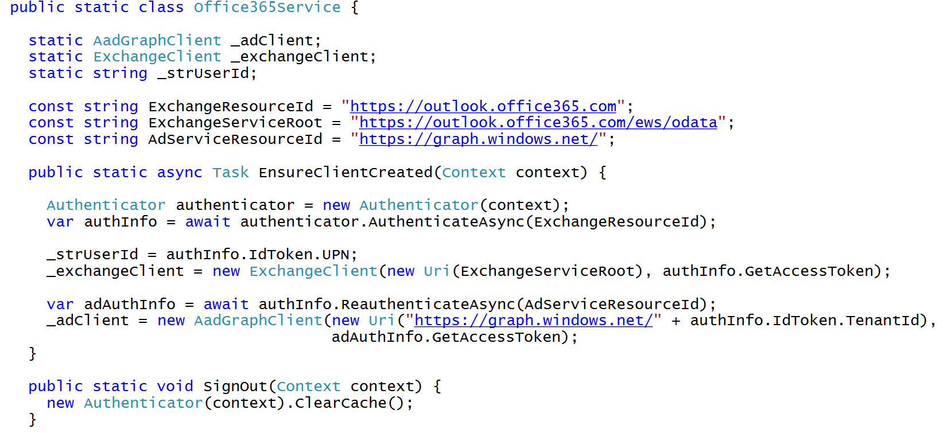
C# Code to Authenticate the User

Slide 39
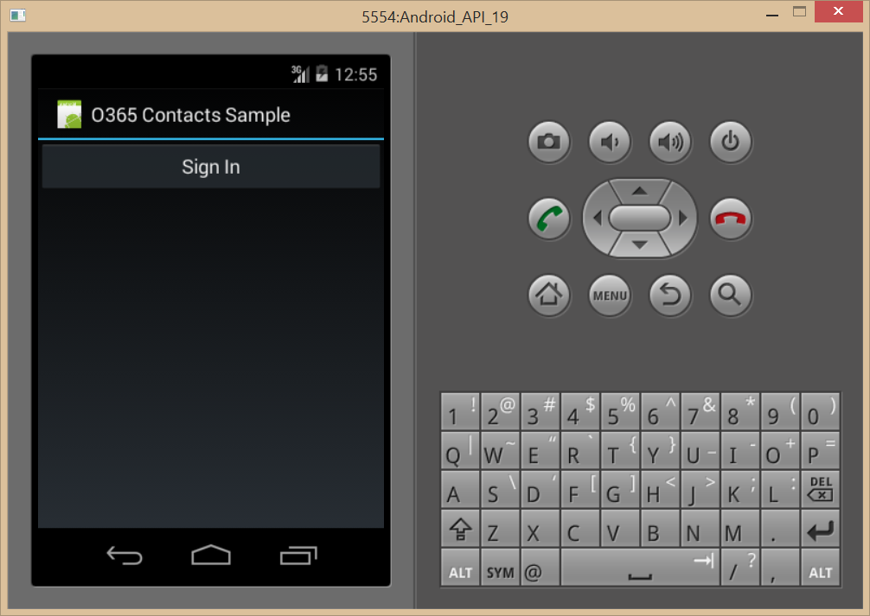
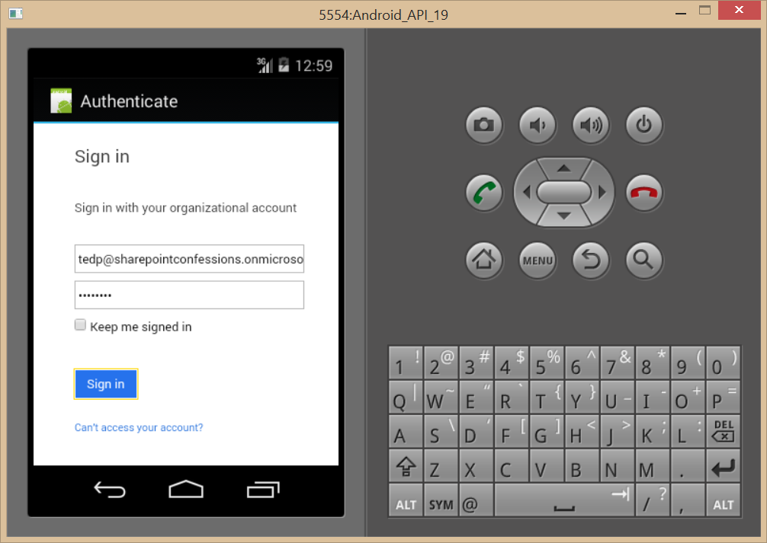
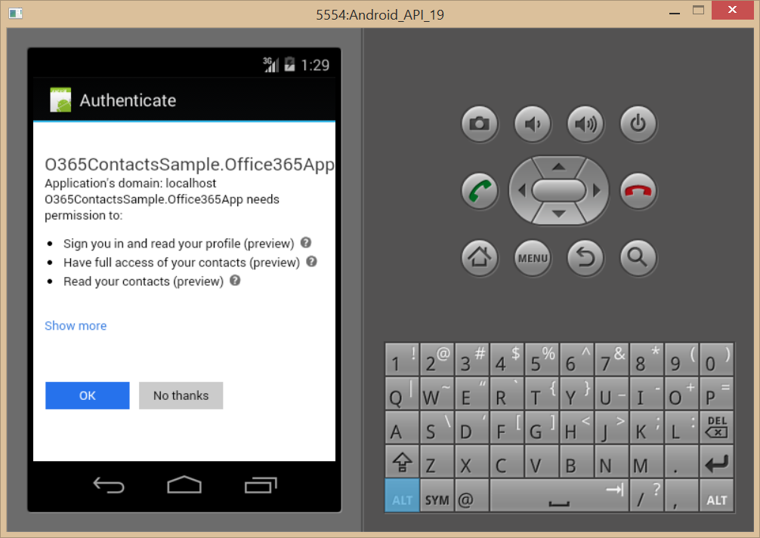
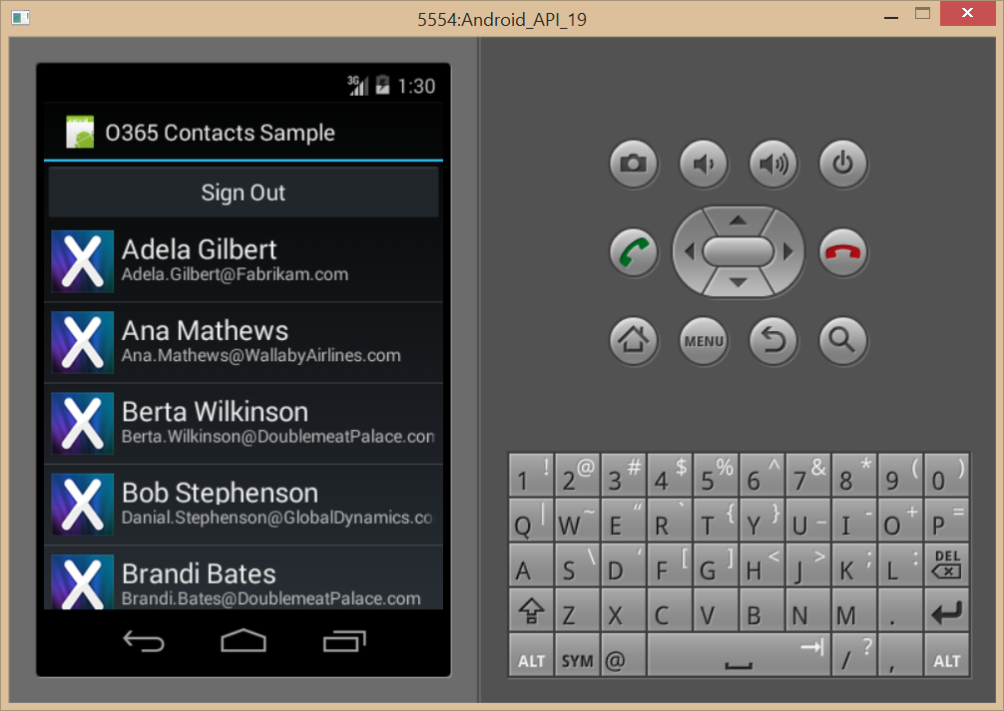
Authentication Flow

Slide 40
demo
XAMARIN

Slide 41
Summary
Intro
Windows Platform
Non-windows Platforms
Multi-platforms

Slide 42



Building skills
Add screens shot from link
Microsoft Virtual Academy
dev.office.com/training
Code Samples
dev.office.com/code-samples
DX Office 365 Dev Camps
Office 365 Summit Developer Tracks
summit.office.com

Slide 43

Make look cool
Developer Patterns & Practices
Transform your code
Providing App Model Patterns for common SharePoint Full Trust Code and Office Add-in scenarios
60+ Visual Studio projects
Common scenarios Branding Site provisioning Remote event receivers
Large file support Taxonomy driven navigation And much more… aka.ms/OfficeDevPnP

Slide 44
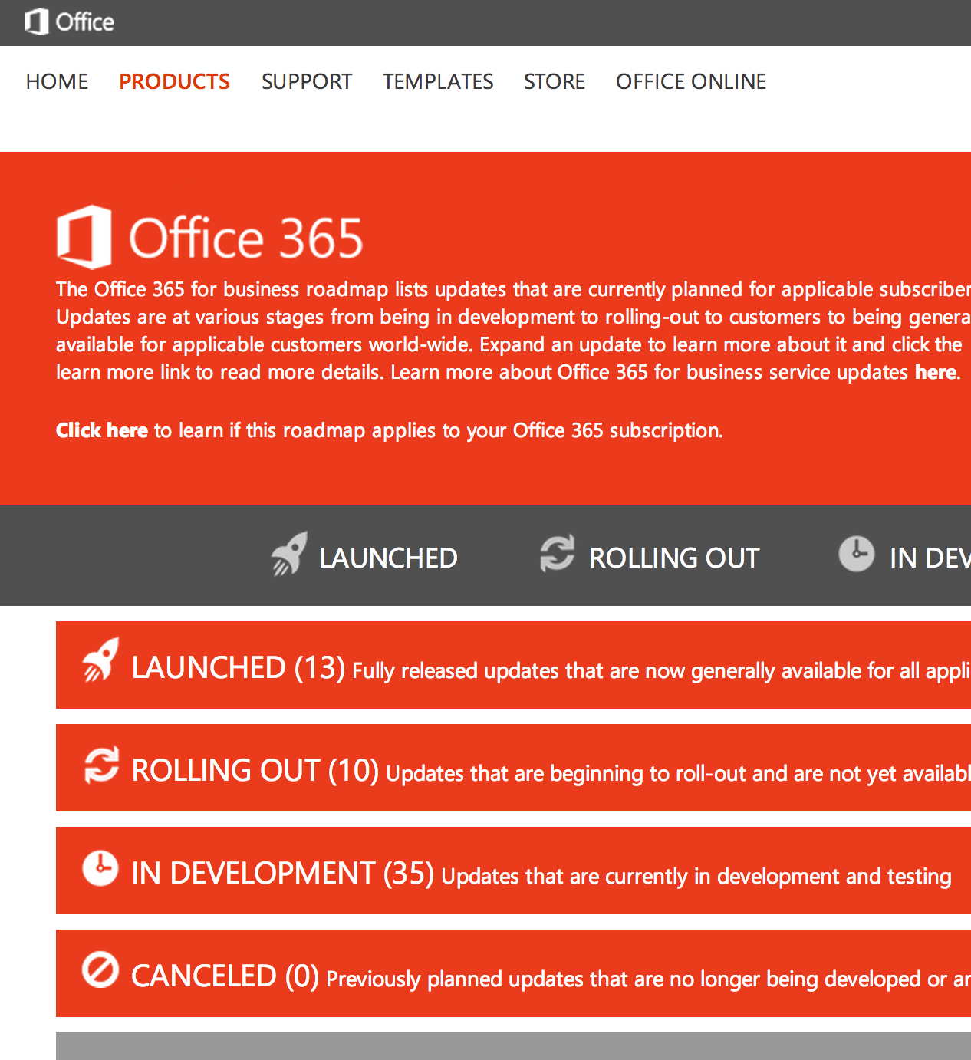
Roadmap
Monthly updates
Associated blog posts
www.office.com/roadmap

Slide 45
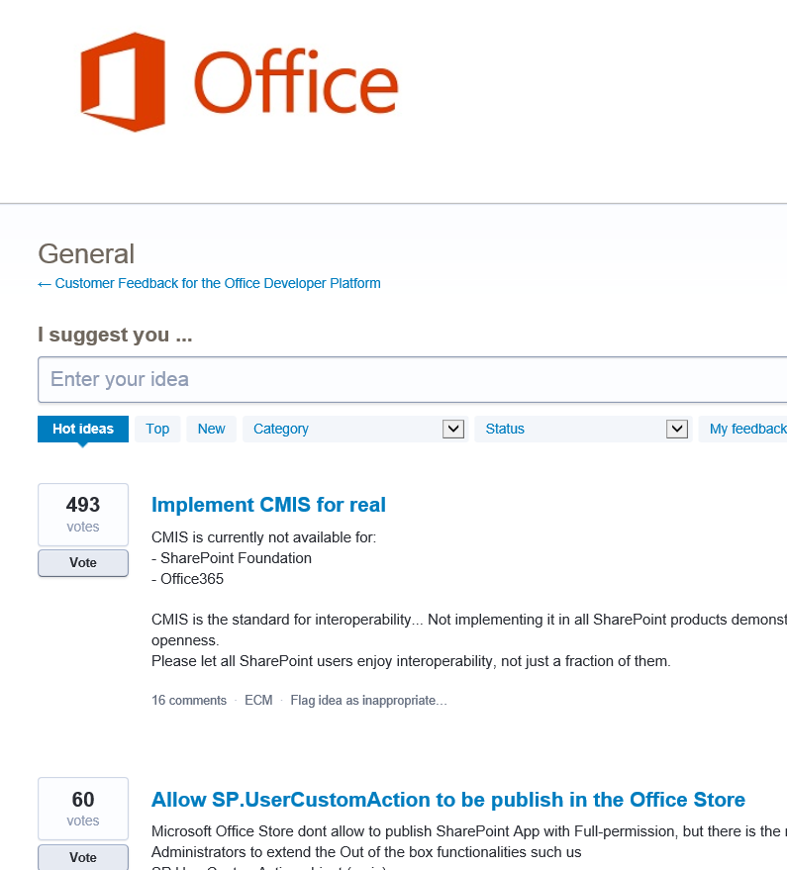

Customer feedback
Yammer Office 365 Technical Network
Stackoverflow
UserVoice Developer focused Bi-weekly triage Link to roadmap to show actions
http://aka.ms/OfficeDevFeedback

